Slide 1
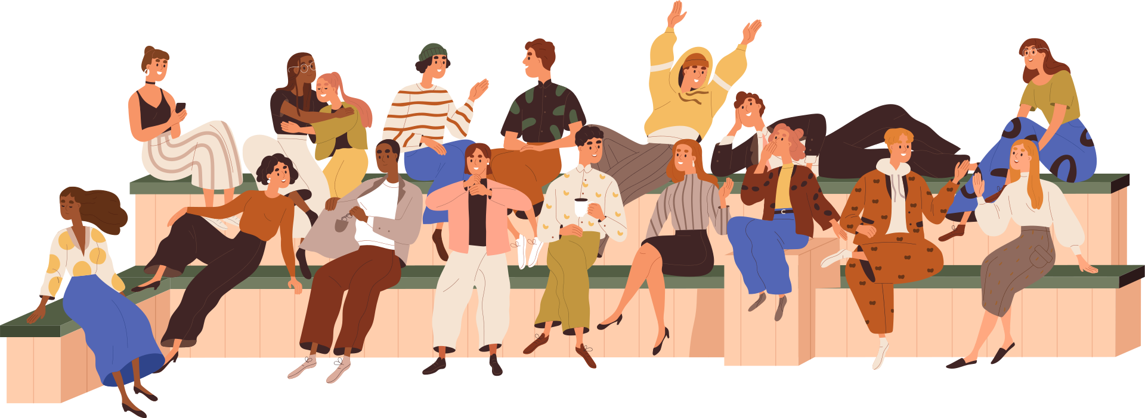
Advocacy 101
Lutheran Engagement and Advocacy in Nevada

Slide 2
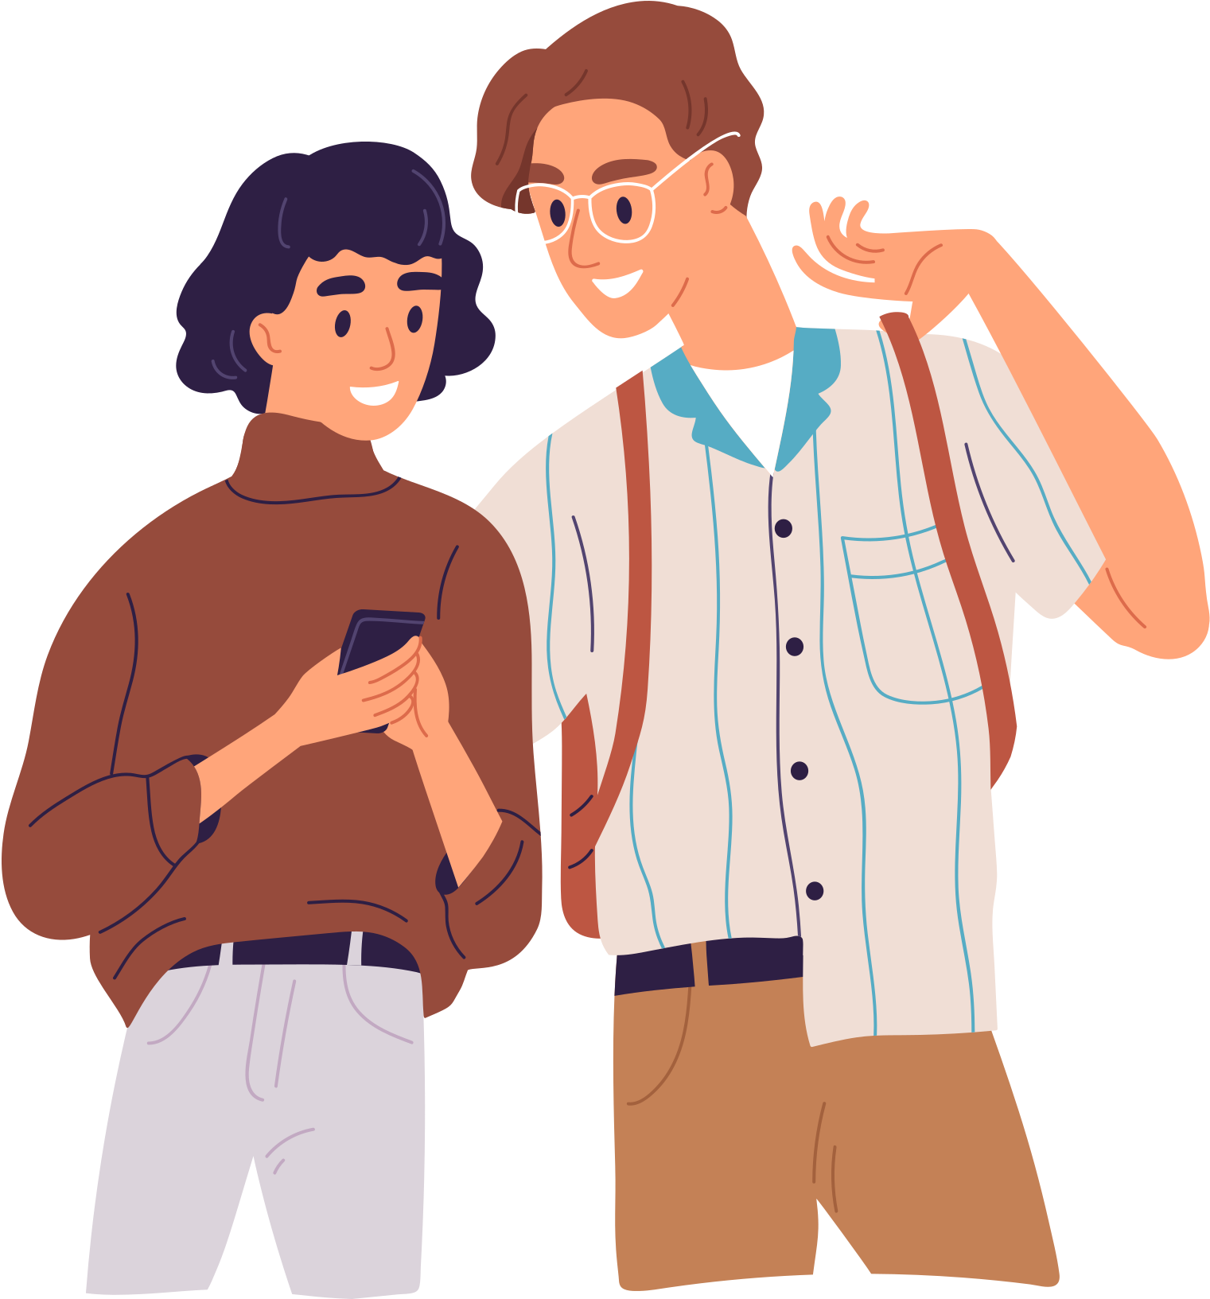
Advocacy STARTS WITH YOU
Why are you here?
I wonder why did you take time out of day to be here?
What do you want to learn?
Notes:
I wonder why did you take time out of day to be here?
What are you hoping to learn?

Slide 3
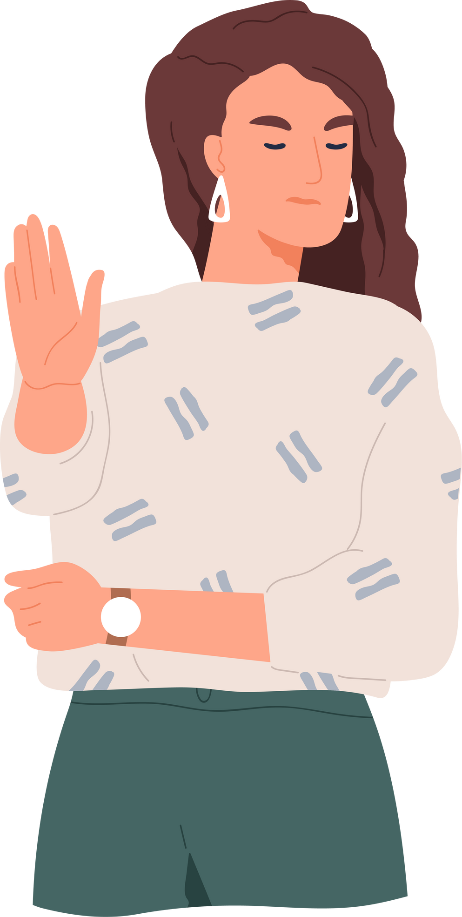
WHAT IS ADVOCACY
The role of advocacy is to:
  Create a relationship with your elected represenative in local, state, and national districts
  STAND UP for those who voices might not be at the table
  Provide and avenue to express your opinons and passions to those who have been elected to serve

Slide 4
WHy Legislative Advocacy
  A Good idea is not enough
  Who are power brokers beholden to and responsible to in the end?
  It is our Responsibility as citizens
  DEMOCRACY begins with you!

Slide 5
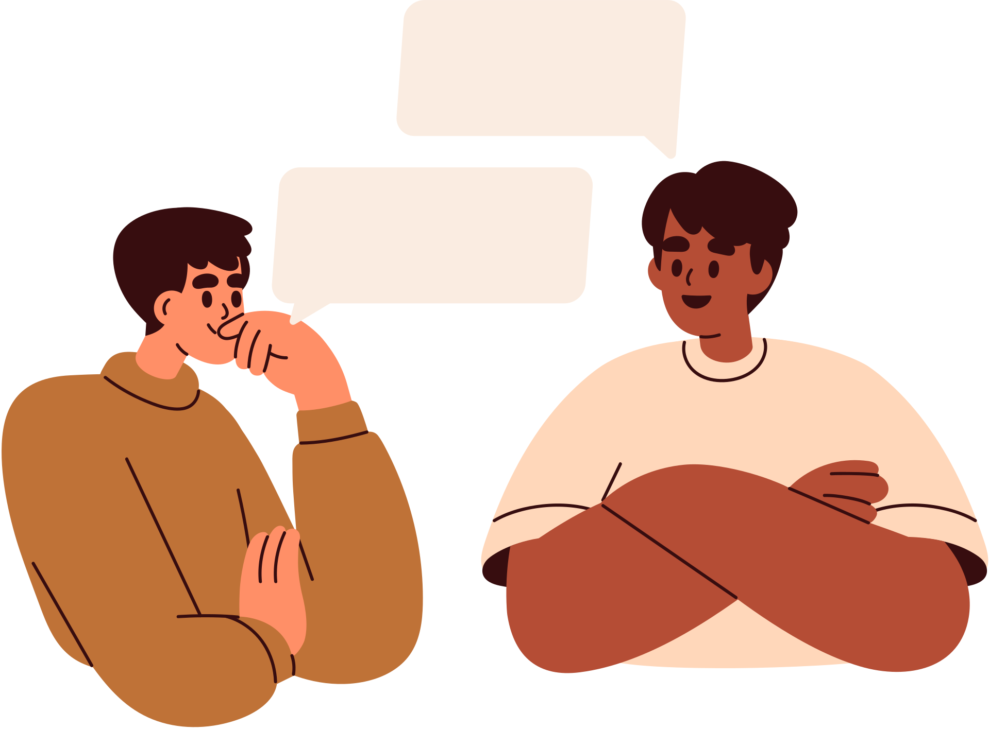
Think about a moment in your life when you stood up for someone, or someone stood up for you?

Slide 6
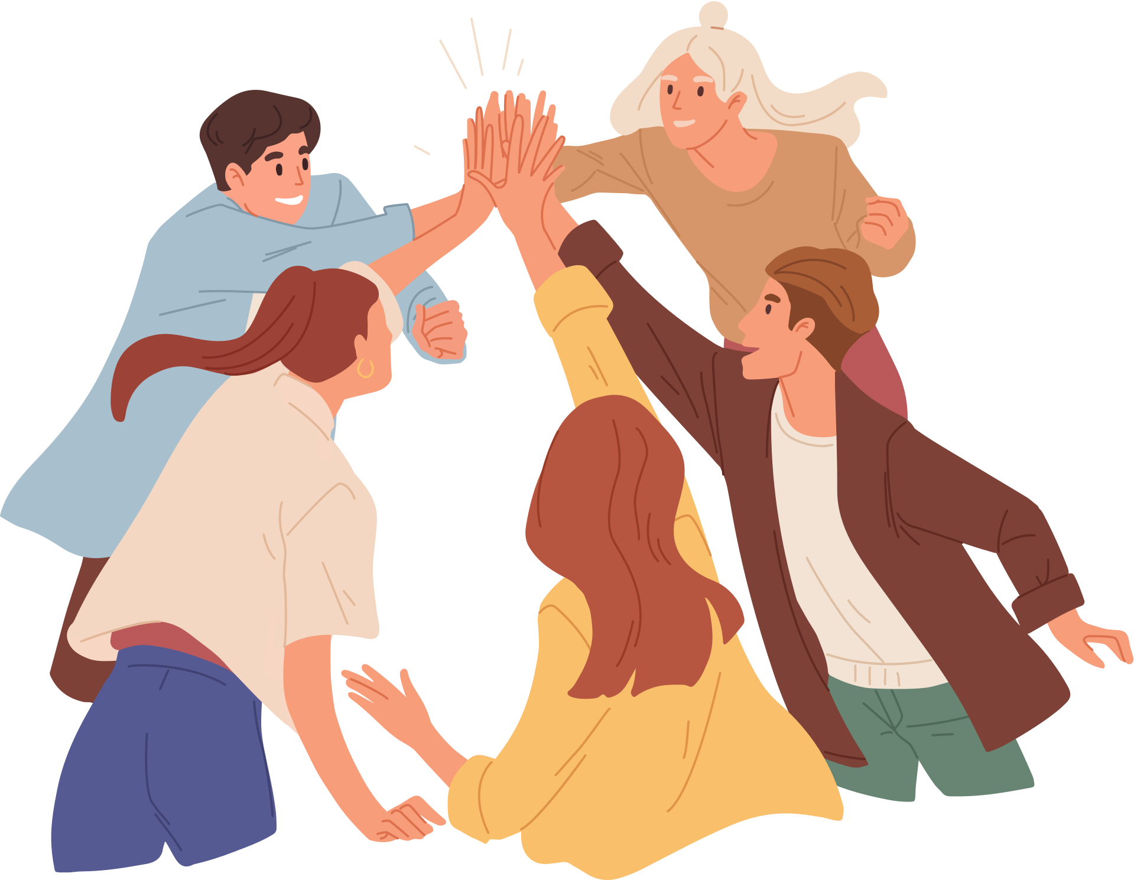
What DOes Policy Have to do with me?
In the morning, you drive to work on the freeway, stopping at a gas station to fill up. After work, you drive across a bridge to get to the state university, where you are taking general education courses. At the end of your day, you and your partner decide to eat a bite and walk in your neighborhood. At home after dinner, you shower before turning off the lights and getting some sleep.
Ponder the role of government in this hypothetical day?

Slide 7
What is the Role of policy?
  Some ideas: Transportation infrastructure ― roads, freeways, public transit ― is built and maintained by governments. Gas, food and medicines are regulated for quality and authenticity by the Food and Drug Administration.
  Employers are accountable to certain legal standards of professional conduct.
  Schools, community colleges and state universities receive government funding.
  If we choose or can marry, we have access to special legal rights and privileges.
  Some of us are protected by the social safety net, which includes Medicaid, tax breaks and supplements to pay for food or housing.
  We may benefit from public utilities such as gas, water and electricity

Slide 8
How do I follow LEGISLATION?

Slide 9

Who is LEAN?
Lutheran Engagement and Advocacy in Nevada advocates for the common good and promotes public policies that reflect the Christian values of peacemaking, hospitality to strangers, care for creation, and concern for people living in poverty and struggling with hunger and disease. We are part of the Grand Canyon Synod and Sierra Pacific Synods.

Slide 10

the 83rd Legislative Session
480+ Legislative Bills (Assembly & Senate)
Housing, Racial Justice, Criminal Justice, Voter Engegement, Creation Care, Immigration, and
Bills INTRODUCED
International Holocaust Remembrance Day
Dolores Huerta Day
Social Media
Wildlife Crossings
Notes:
These are just a couple of the bills and the items up for discussion
484 as of last night, and that number I am sure is already grown

Slide 11
HERE ARE THE BILLS to follow (ASSEMBLY)
  AB 63: This would allow for wrongfully convicted people to get college tuition, medicare and housing assistance
  AB65: This would establish safeguards for children whose parents face deportation. Those measures include access to legal, social and educational resources.
  AB 67: This would establish the Nevada Baby Bonds Program and the Nevada Baby Bonds Trust Fund;
  AB 150: This would prohibit a person from harrasing and intimidating tribal judges
  AB 201: This would automaticly seal of certain eviction case court files under certain circumstances
  AB 229: This would revise the deadline for mail in ballots to be post marked by the last day of early voting

Slide 12
HERE ARE THE BILLS to follow (SENATE)
  SB14: This would prohibit anyone arrested for domestic violence to be allowed pretrial release on bail.
  SB 103: This would revise the deadline for mail in ballots to be post marked by the last day of early voting
  SB 112: This would probit particpation in higher education athletics by indivudlas not assigned at their birth
  SB 123: This would prohibits local governments from enacting rent control. (BDR 20-723)
  SB 171: This would shield and protect the transgender community.

Slide 13
Examples of Assemblymember PK O’NeilL
  AB 229: Cosponsor

Slide 14
Examples of Assemblymember SELENA LA RUE HATCH
  AB 179: Cosponsor

Slide 15
Examples of Senator Robin Titus
  SB 103 - Cosponsor

Slide 16
Advocate to Legislator
  Lead the meeting
  Thank the legislator or legislative assistant for meeting with you. Thank you for taking the time to meet with me today.
• Introduce yourself and, if applicable, the organization you are representing.
  Hi! My name is [name] and I am a here to advocate on behalf of Lutherans in Nevada....

Slide 17
Advocate to Legislator (CONT.)
  Briefly share about yourself. Share if you live in the legislator’s district, if you have volunteered with the office, what your role is at your organization, or if you have anything else you think they should know about you. I am a constituent of your district, and I work as a direct support professional supporting people with disabilities.
  Briefly explain why you are meeting with them. If you are meeting with them to talk about proposed legislation, identify the House File (HF) or Senate File (SF) number, and clearly state your position on the proposed legislation. Take a few minutes to share three to four reasons why you support or oppose it. Make it persuasive! Sharing about how proposed legislation impacts you can be very impactful. Use simple, clear language. Avoid using acronyms or words that others outside of your profession may not know. I am here today in support/opposition to HF/SF XXXX. I support/oppose this because... It will have this impact on me...

Slide 18
Things to Remember when Meeting your Legislator
Visits are often short, 10-15 mins
Have an outline of who will lead the meeting and who will speak about what and when
Leave time for the policymaker to ask question
IF you get anxious, remember you are NOT alone
Representatives are people just like us!
Be Polite! Find common ground
YOU ARE BUILDING A RELATIONSHIP

Slide 19
SHARE YOUR STORY
  Stories are powerful bridge builders between people. Your stories matter, whether from your own life, your faith community, your school, your friends or even people you value but may not know well.

Slide 20
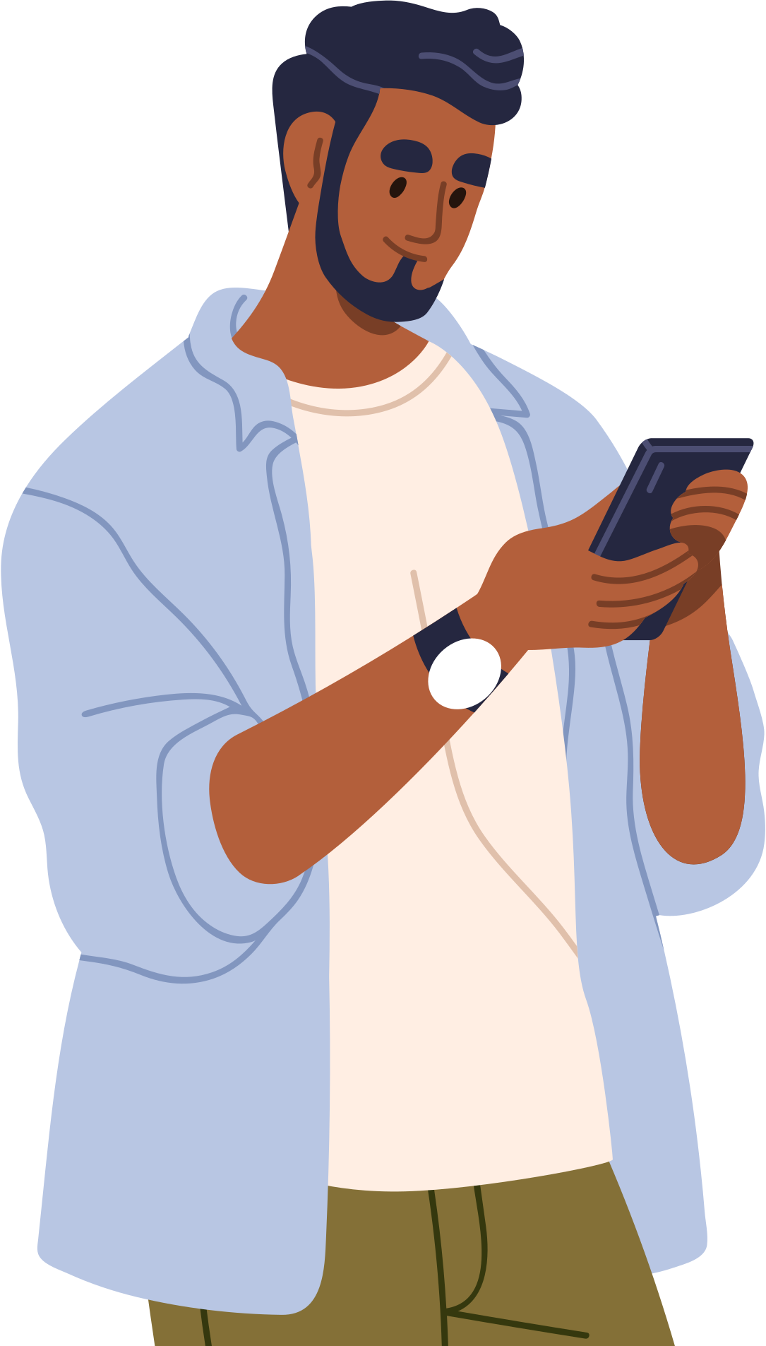
SHARE YOUR STORY
ME: Who am I, and why am I here?
YOU: What do I want you to do?
WE: How can we work together?

Slide 21
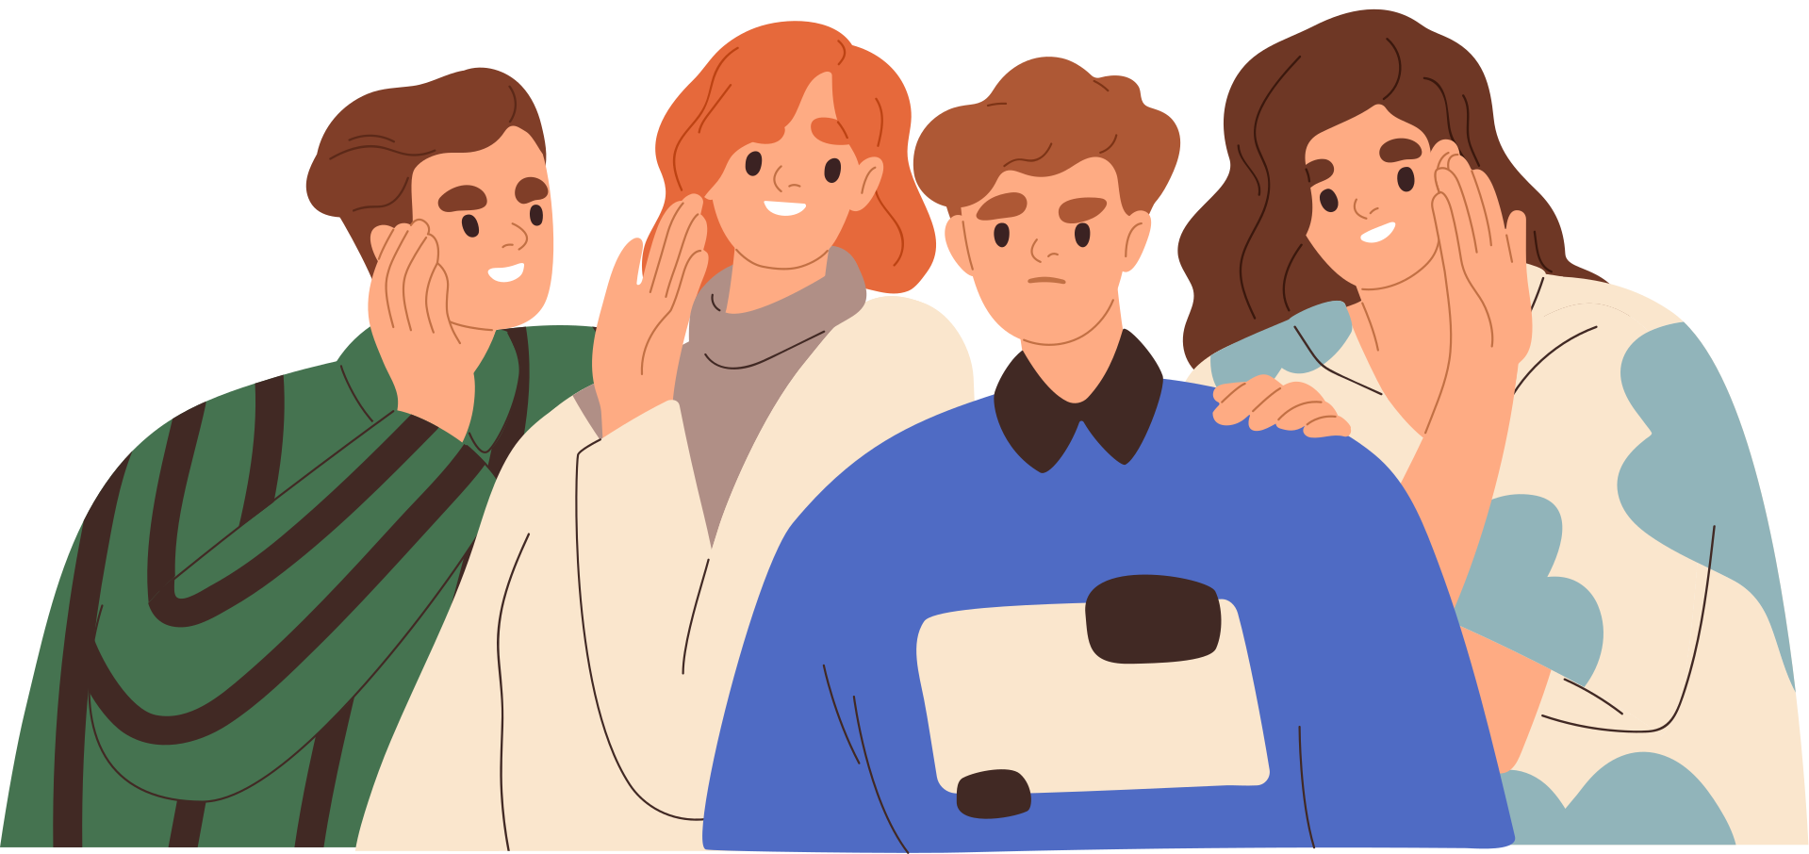
Elevator Speech
  An elevator speech is a speech of 30 to 40 seconds ― the time it takes to ride an elevator with someone ― that draws that person into further conversation or connection. When time is limited, it’s a way of foregrounding who you are and what you care about. To get your point across succinctly, try using a “me/you/we” format. Always end a lobbying visit with an “ask,” requesting that your legislator commit to a vote or an action, so that later you can hold them accountable.

Slide 22
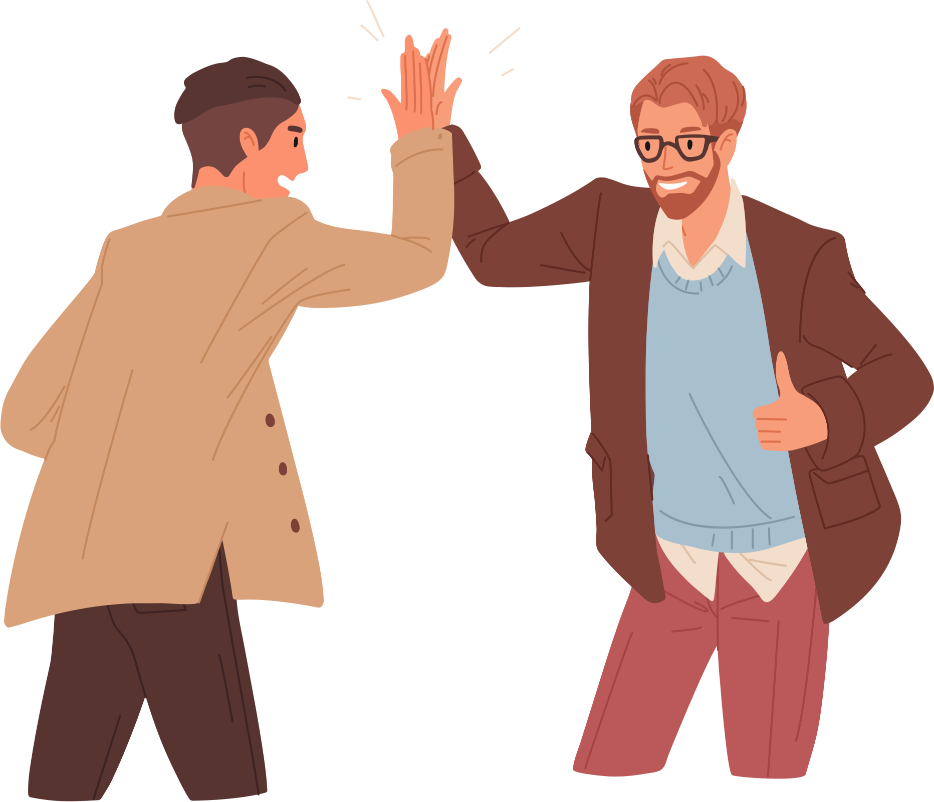
ACTIVITY- SPEED LOBBYING
  1. Think About an Issue – Take a moment to reflect on an issue you care about.
  2. Create Your Elevator Speech – Use the “me/you/we” framework to craft a short, persuasive message. Practice with a partner.
  3. Form Two Lines – One line will be advocates, and the other will be legislators or staff. Each person faces a partner.
  4. First Round (Positive Response)
- Advocates give their elevator speech.
- Legislators respond positively to the request.
- Switch partners and repeat.

Slide 23
ACTIVITY- SPEED LOBBYING
  5. Second Round (Neutral/Negative Response)
- Legislators now respond neutrally or negatively
- Advocates adjust their message to persuade them.
- Switch partners and repeat.
  6. Keep Rotating– Move to a new partner after each round, like speed dating.
  7. Switch Roles– Advocates become legislators and vice versa. Repeat the process.
  8. Group Reflection – Discuss the experience. Was it easy or awkward? What strategies worked best?

